Slide 1


Project Guide Dr. K.Kumar M.E., Ph.D., Associate Professor
CRIME PREDICTION ANALYSIS IN LOCATION
TEAM MEMBERS
Divya A(1817116)
Hafeeza Begum M (1817118)
Keerthana K(1817123)
Pavithra T(1817137)

Slide 2
PROBLEM STATEMENT
Predict safe or unsafe location depends on the past crime rates in that location and classify the higher rate of crime type happening in that location.
PROPOSED SYSTEM
Machine learning techniques can be used to predict crime patterns and thus may assist in further necessary actions based on historical data.
Crime prediction
Exploratory Data Analysis can be used to predict crime severity in location by city, district and ward wise based on historical data.
Map the area with severity levels with indicators

Slide 3
WORK FLOW
Data Preprocessing
Data Exploration
Data Modeling
Binary Classification
Multi Class Classification
ML Algorithms
ML Algorithms
Compare Testing Accuracy
Compare Testing Accuracy
Stop
Stop

Slide 4
Literature Survey
IDEAS | DISADVANTAGE
Crime analysis and prediction using data mining | Efficiency of Mining Algorithms and performance is Less
Crime analysis and prediction using Artificial Neural Networks | Having Fault Tolerance leads to loss of performance

Slide 5
Data Preprocessing
Clean up the crime dataset obtained from the city of Chicago data portal.
Used the most recent data from year of 2018 to 2022 from the Chicago crime dataset, instead of using the whole dataset which contains more than 8million records back to year 2001.
Chose not to use earlier data because the distribution of crimes can change over time due to various reasons and the most recent 4 to 5 years will be more relevant to the current situation since problem as a classification problem instead of a time-series problem.

Slide 6
Cleaning up data
Step 1 : Excluded records with vague information . There are a lot of information but some unnecessary columns are also removed.
Step 2 : Removed extremely rare crime types and locations . Dropped crimes that happen at extremely unlikely locations, and only kept crimes that happen at the top 25 locations. Even after two rounds of filtering, we still kept around 85% of the crimes.
Step 3 : Converted categorical features to dummy (indicator) variables for classification . Checked some other features that can be used for the classifier and Converted crime type, police district, and location description into dummy variables.
Step 4 : Extracted the time information and converted categorical features to dummy variables For each crime time record segmented the time into eight blocks of 3-hour, for example 0-3am, 3-6am, etc and created indicator variable based on that.
Step 5 : Added an extra feature "distance to closest police station" calculated an additional feature using the coordinate info the distance of the location to the closest police station.
Step 6 : Integrated socioeconomic status of the neighborhood where the crime happened Given a location, there are other relevant information such as income, education level and population structure of the neighborhood.

Slide 7
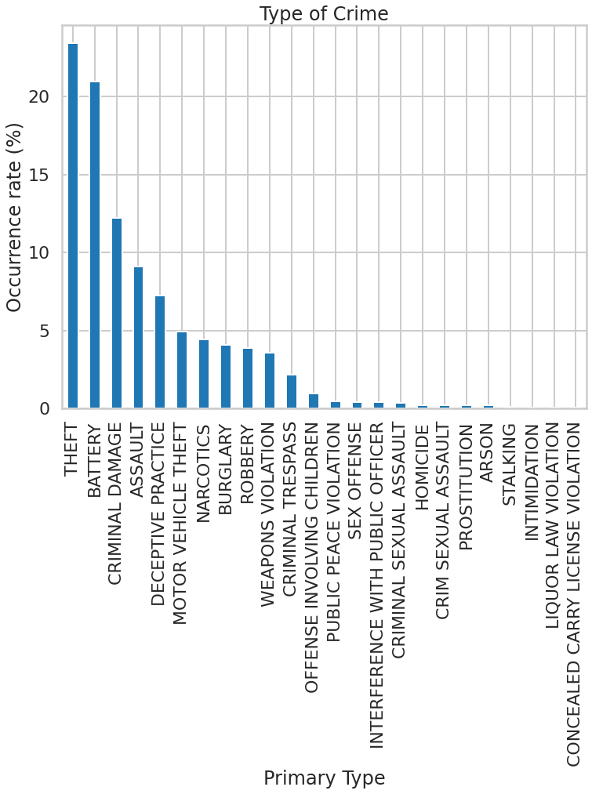
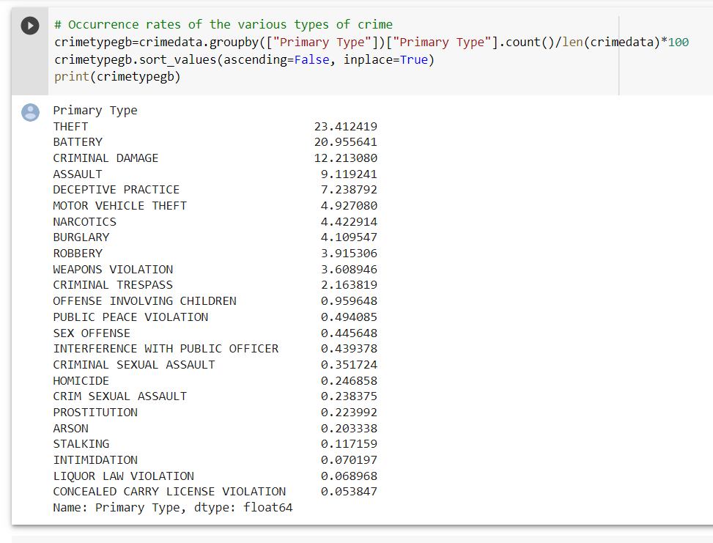
Data Exploration
Types of crime

Slide 8
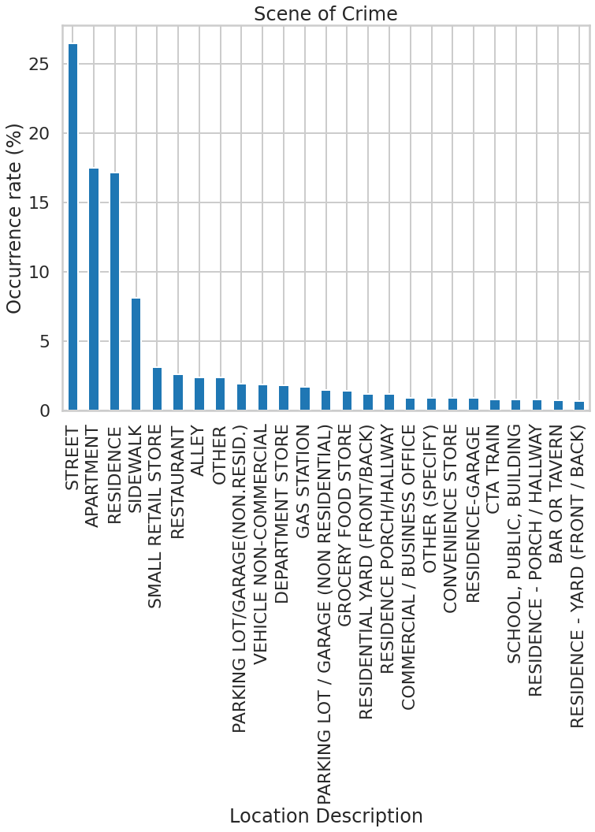

Data Exploration
Crime Rate in Location

Slide 9
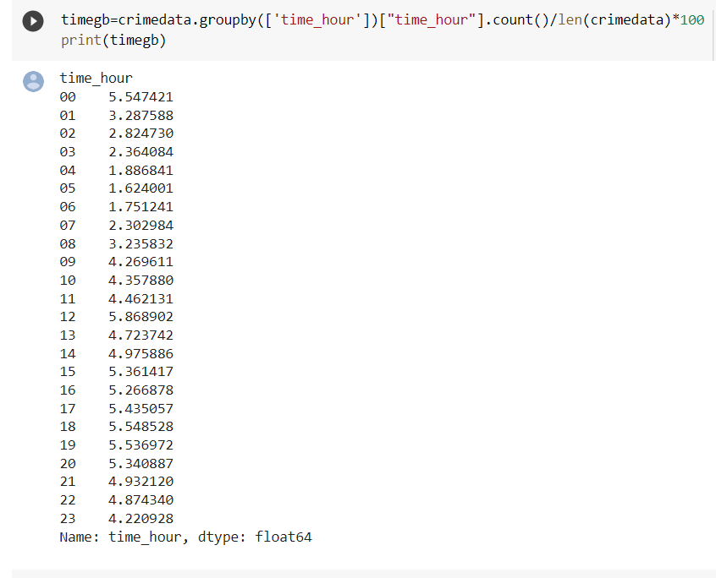
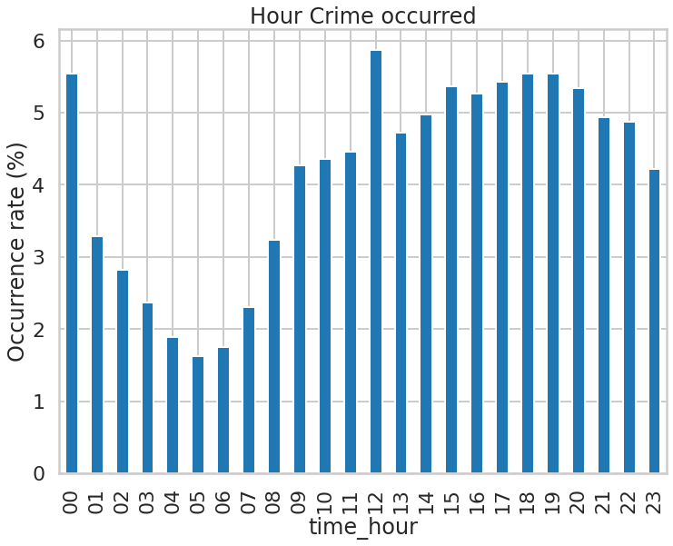
Data Exploration
Crime Rate on Hourly basis

Slide 10
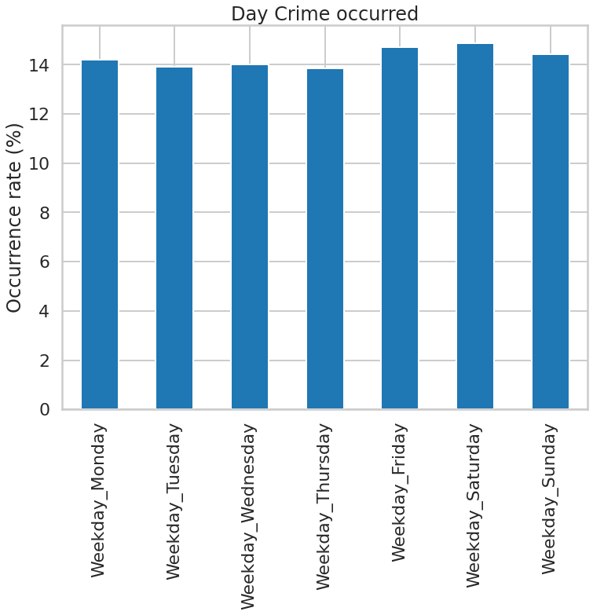
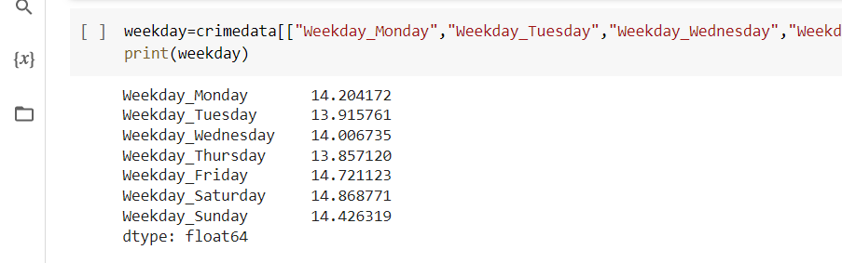
Data Exploration
Crime Rate on Daily basis

Slide 11
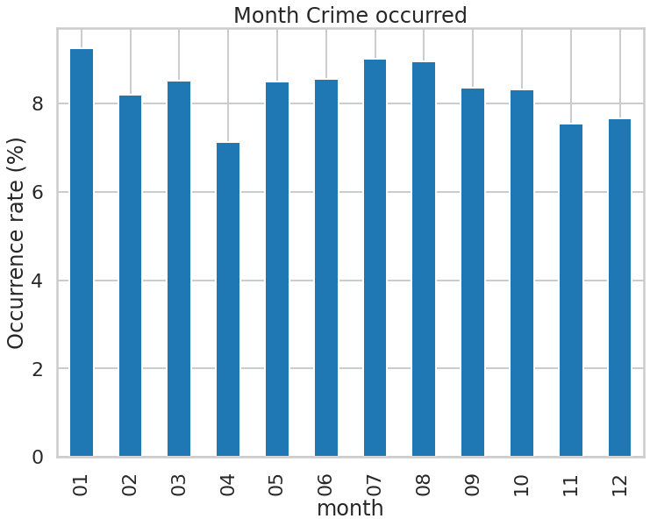
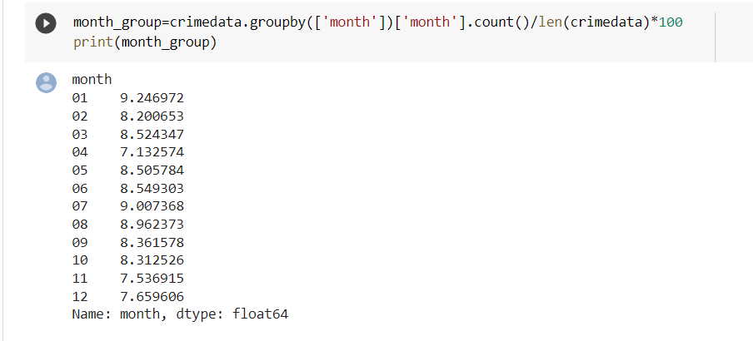
Data Exploration
Crime Rate on Monthly basis

Slide 12
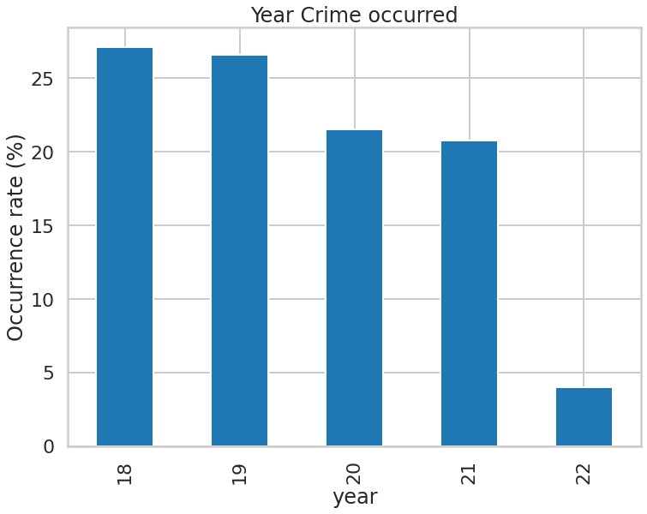
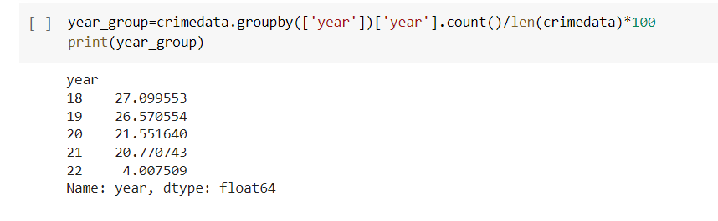
Data Exploration
Crime Rate on Monthly basis

Slide 13
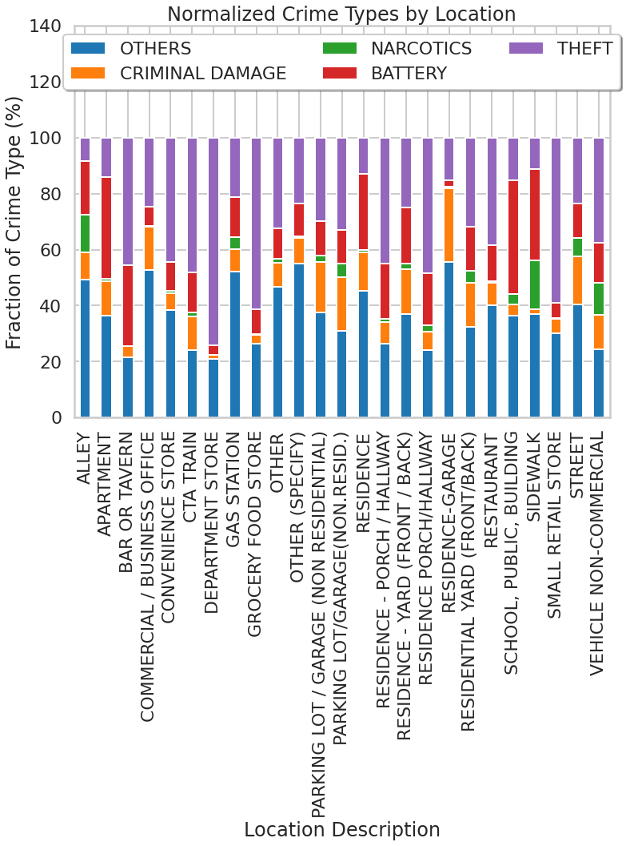
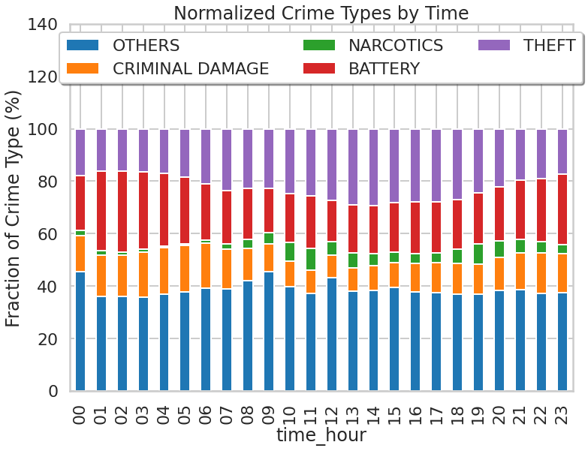
Data Exploration
Variantion of Crime in Location
Variantion of Crime in Hour

Slide 14
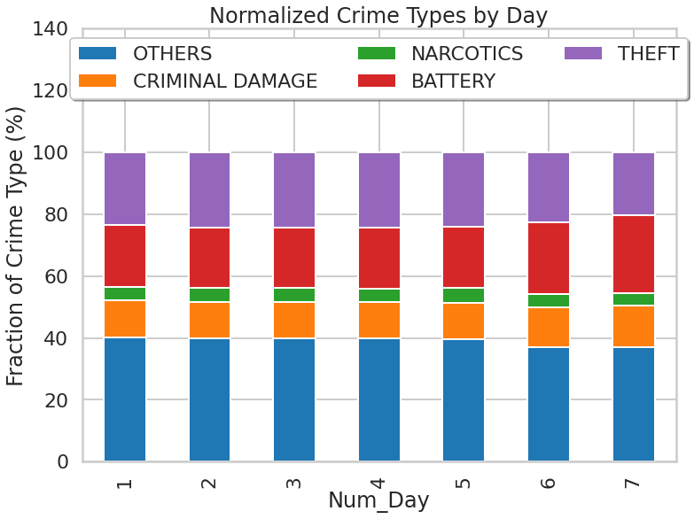
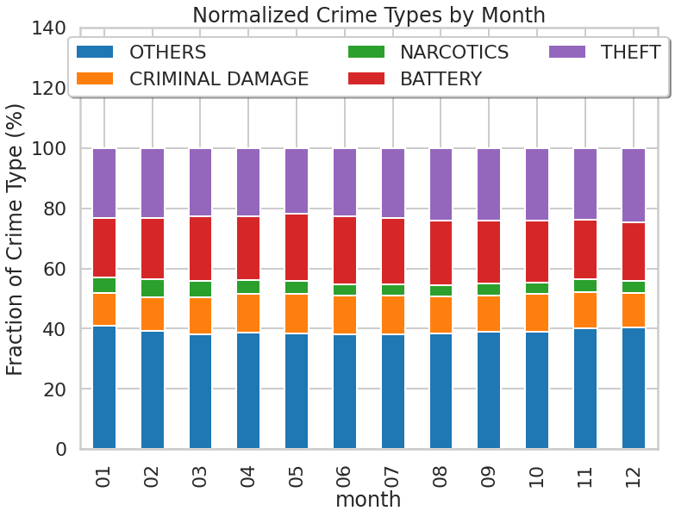
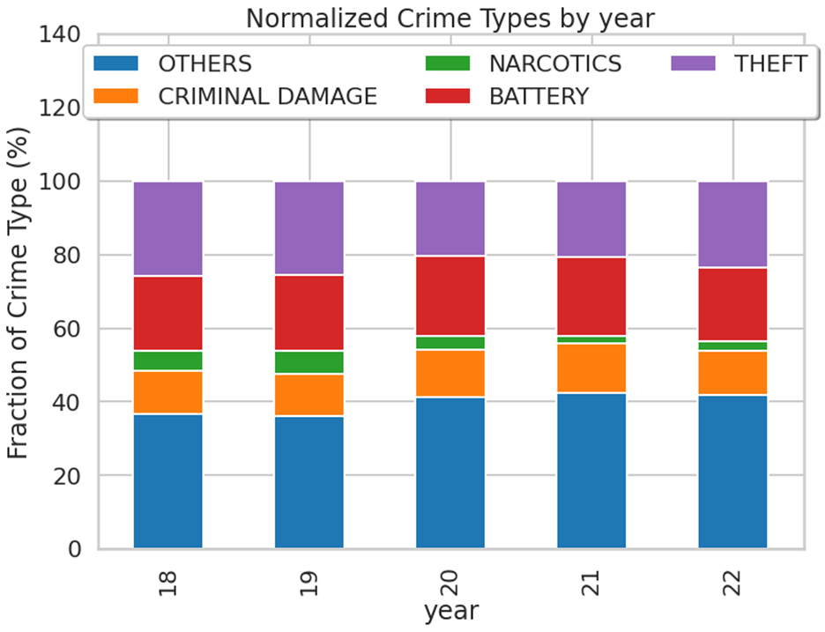
Data Exploration
Variantion of Crime in a Month
Variantion of Crime in a Day
Variantion of Crime in a Year

Slide 15
Data Modeling
Two types of models :
Binary classification model
Multi-class classification model
Binary classification model
To predict severity of the crime we use binary classification.
The features that required normalization Latitude, Longitude, closest_station. Other features for our dataset are all categorical data and have all been converted to dummy variables (District, Time_block, Weekday, Location description).
Perform spliting on the 80000 sample records into training set and test set , normalized by themselves.
Latitude and longitude info may be helpful for classification. if the latitude and longitude is low, it’s more likely that severe crime will happen .This is consistent with the fact that the safety at south Chicago is notoriously bad.
The time block is 3am to 6am, the proportion of severe crime is obviously higher, whichis not the case in time block 9am to 12pm.
The "severe" crime accounts for 46% of the total crime, while the "non_severe" is around 53%.

Slide 16
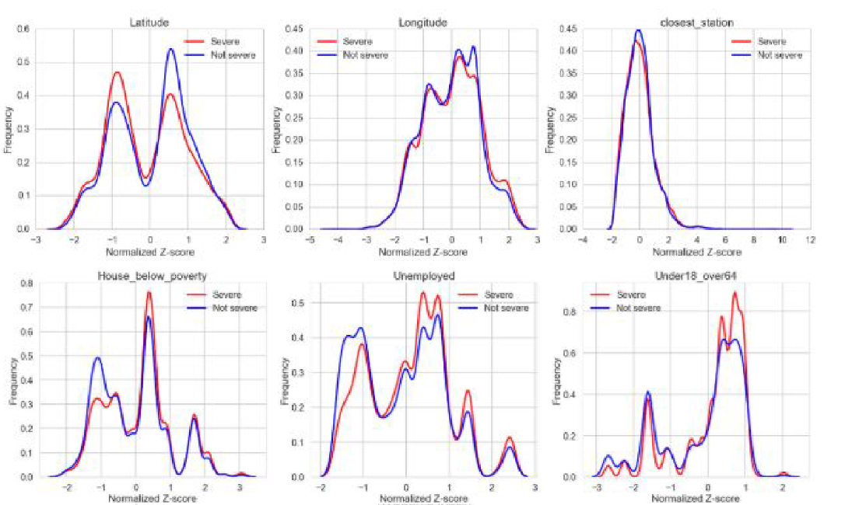
Binary classification model

Slide 17
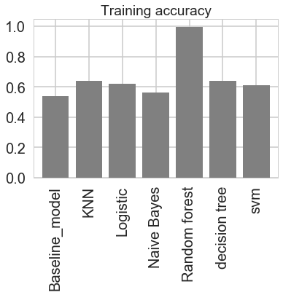
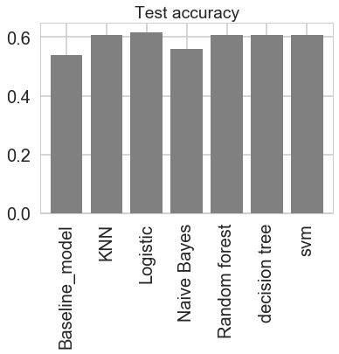
Binary classification model

Slide 18
Multi-class classification model
Useful to determine the exact type of crime.
Here there are 25 classes of crimes but the computational resources does not allow us to do multiclass classification at this scale.
Picking up top four types of crimes which are high in crime rate compare to other crimes, those are
Theft
Battery
Criminal Damage
Narcotics
Classify crime records into four major types of crimes.

Slide 19
Reference
W. Safat, S. Asghar and S. A. Gillani, "Empirical Analysis for Crime Prediction and Forecasting Using Machine Learning and Deep Learning Techniques," in IEEE Access, vol. 9, pp. 70080-70094, 2021, doi: 10.1109/ACCESS.2021.3078117.
Pratibha, A. Gahalot, Uprant, S. Dhiman and L. Chouhan, "Crime Prediction and Analysis," 2nd International Conference on Data, Engineering and Applications (IDEA), 2020, pp. 1-6, doi: 10.1109/IDEA49133.2020.9170731.
Sathyadevan, Shiju & S., Devan & Gangadharan, Surya. (2014). Crime Analysis and Prediction Using Data Mining. 10.1109/CNSC.2014.6906719.
Alkesh Bharati, Dr Sarvanaguru RA.K. “Crime Prediction and Analysis Using Machine Learning.” International Research Journal of Engineering and Technology vol. 5 (2018): 1037-1042

Slide 20
Thank you

